Slide 1
Algorithms
Lecture 3
Sorting with Divide and Conquer
Prantik Paul [PNP]
Lecturer
Department of Computer Science and Engineering
BRAC University

Slide 2
Bubble Sort
def bubble_sort(arr):
n = len(arr)
for i in range(n-1):
for j in range(n-i-1):
if arr[j] > arr[j+1]:
temp = arr[j]
arr[j] = arr[j+1]
arr[j+1] = temp
Worst Case Complexity? Best Case Complexity?
Space Complexity?
Optimization?

Slide 3
Selection Sort
def selection_sort(arr):
n = len(arr)
for i in range(n):
min_idx = i
for j in range(i+1, n):
if arr[j] < arr[min_idx]:
min_idx = j
arr[i], arr[min_idx] = arr[min_idx], arr[i]
Worst Case Complexity? Best Case Complexity?
Space Complexity?
Optimization?

Slide 4
Insertion Sort
def insertion_sort(arr):
n = len(arr)
for i in range(1, n):
key = arr[i]
j = i - 1
while j >= 0 and key < arr[j]:
arr [j+1] = arr[j]
j = j -1
arr[j+1] = key
Worst Case Complexity? Best Case Complexity?
Space Complexity?
Optimization?

Slide 5
Divide and Conquer Strategy
Divide
the problem (instance) into subproblems.
the subproblems by solving these recursively (or iteratively).
Conquer
Combine
the solutions to the subproblems.

Slide 6
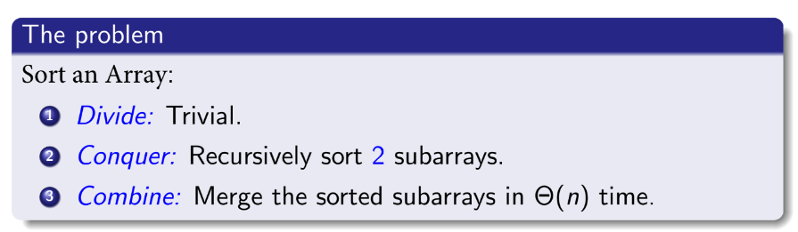
Merge Sort

Slide 7
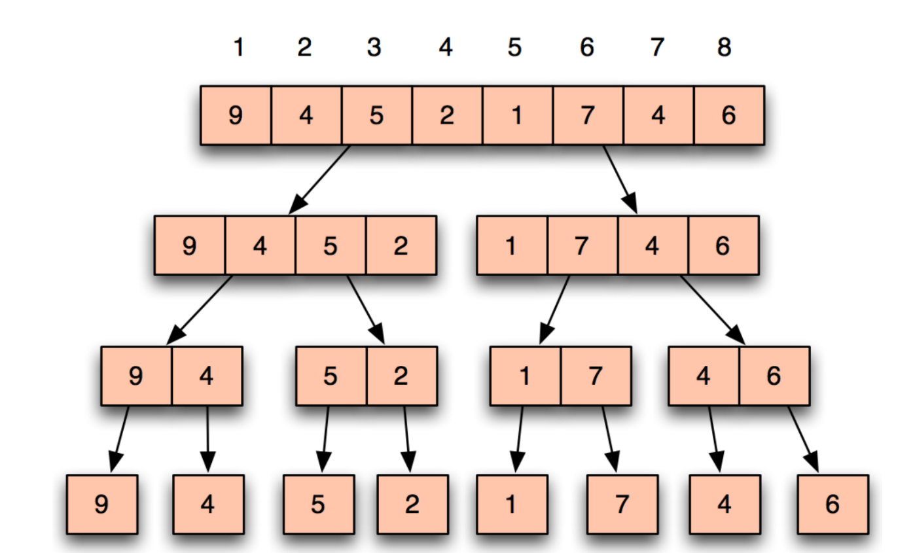
Merge Sort (Simulation)

Slide 8
Merge Sort (Simulation)

Slide 9
Merge Sort (Simulation)

Slide 10
Merge Sort (Simulation)

Slide 11
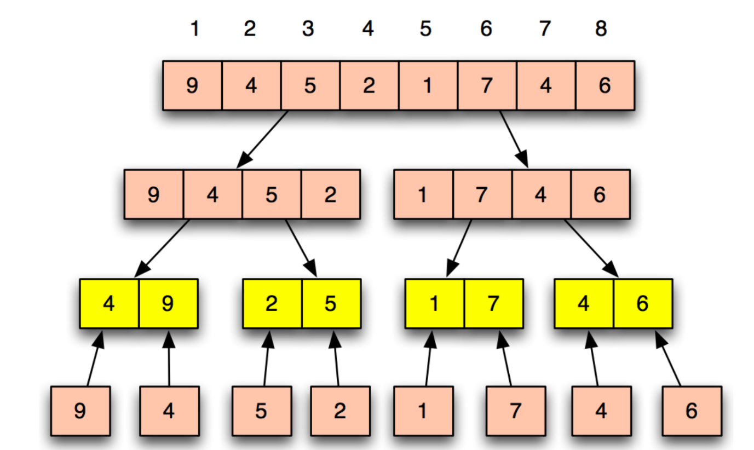
Merge Sort (Simulation)

Slide 12
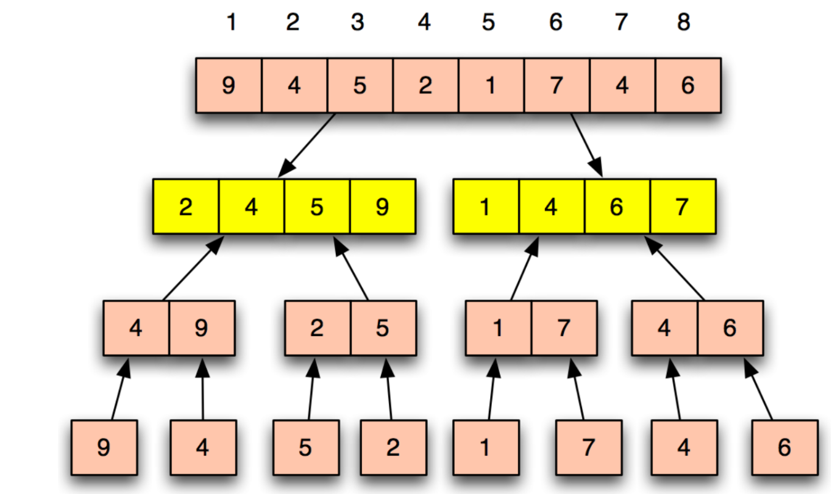
Merge Sort (Simulation)

Slide 13
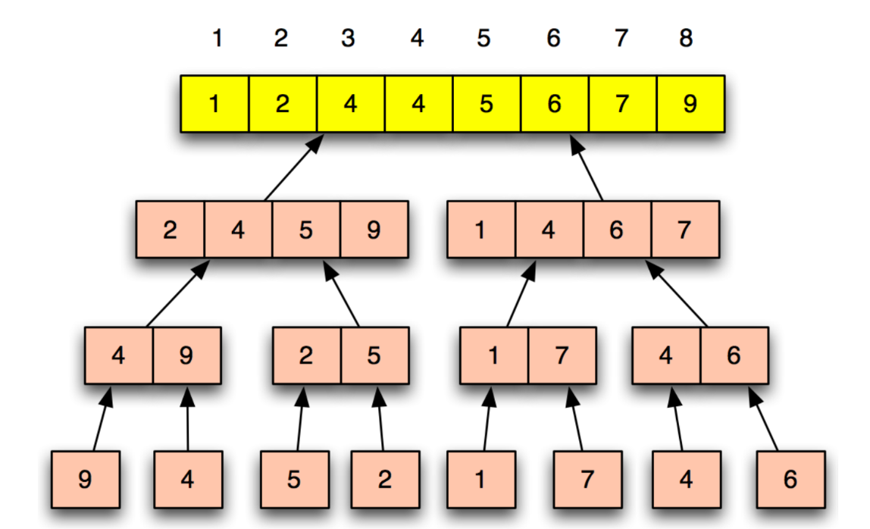
Merge Sort (Simulation)

Slide 14
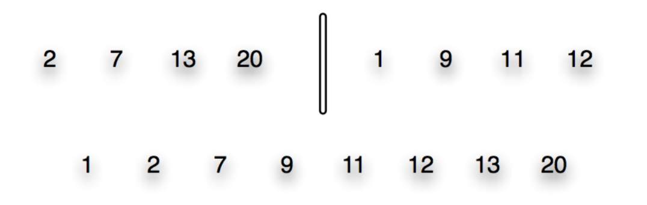
Merge (Simulation)

Slide 15
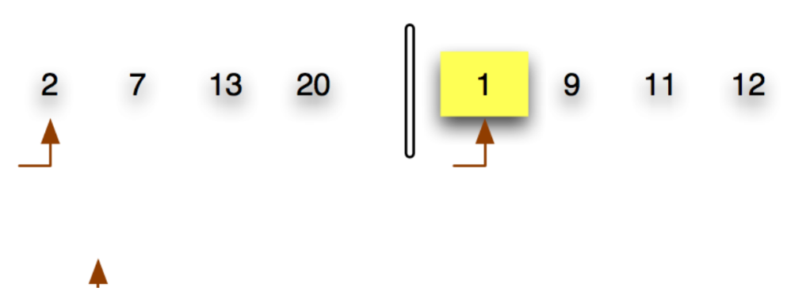
Merge (Simulation)

Slide 16
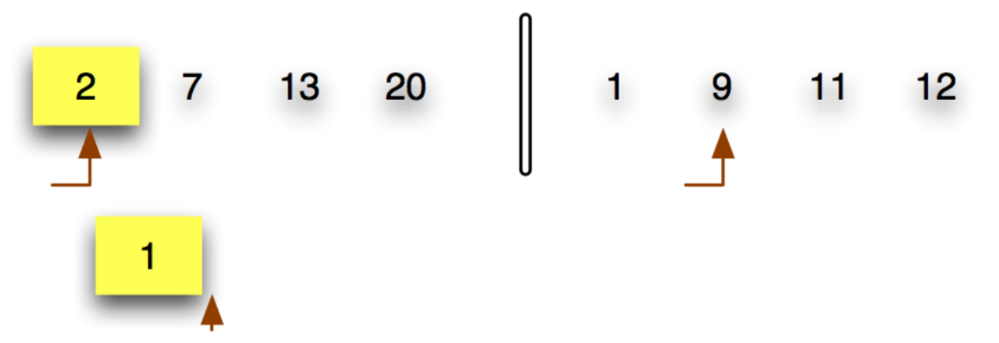
Merge (Simulation)

Slide 17
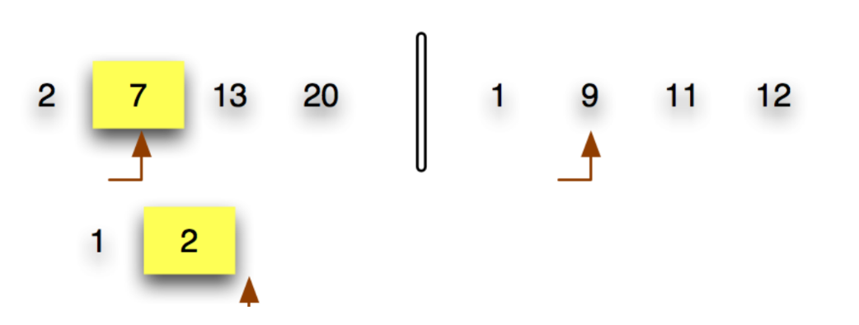
Merge (Simulation)

Slide 18
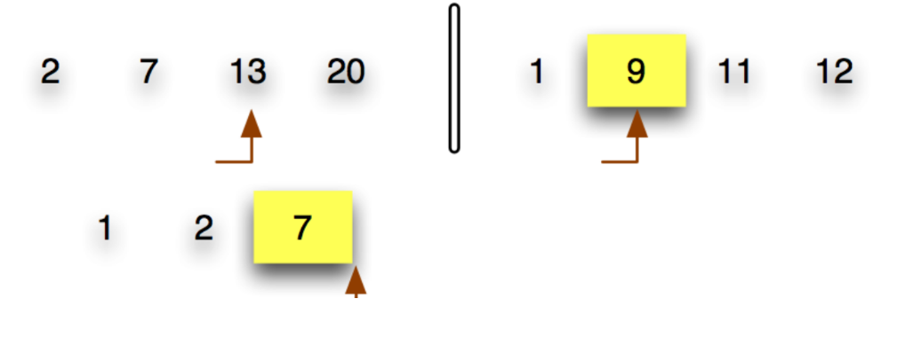
Merge (Simulation)

Slide 19
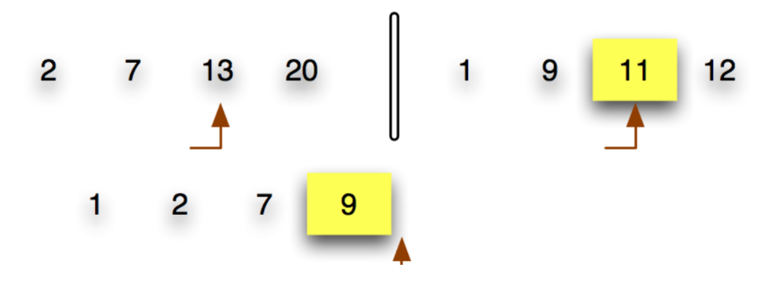
Merge (Simulation)

Slide 20
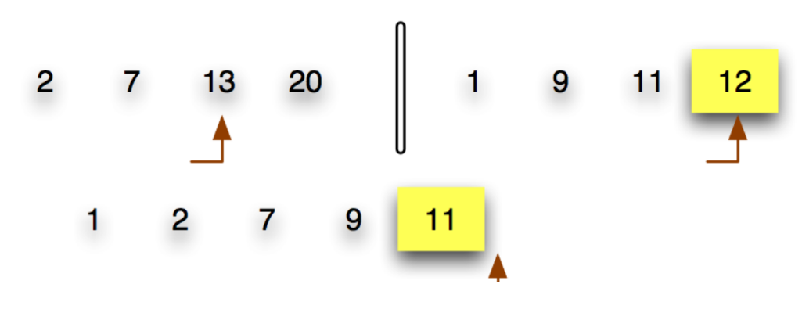
Merge (Simulation)

Slide 21
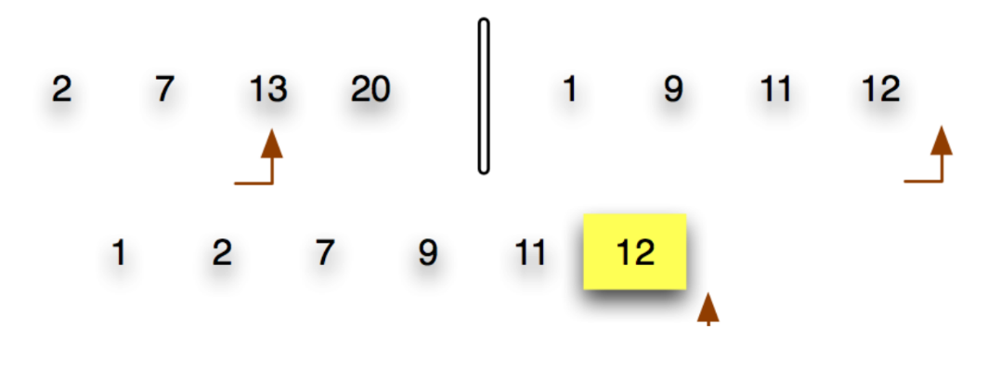
Merge (Simulation)

Slide 22
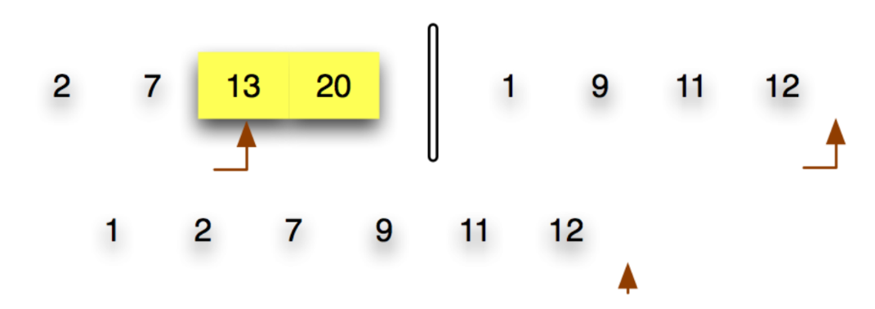
Merge (Simulation)

Slide 23
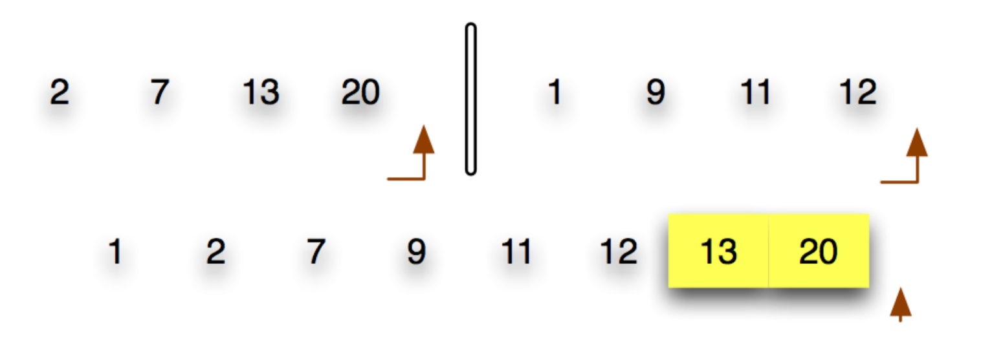
Merge (Simulation)

Slide 24
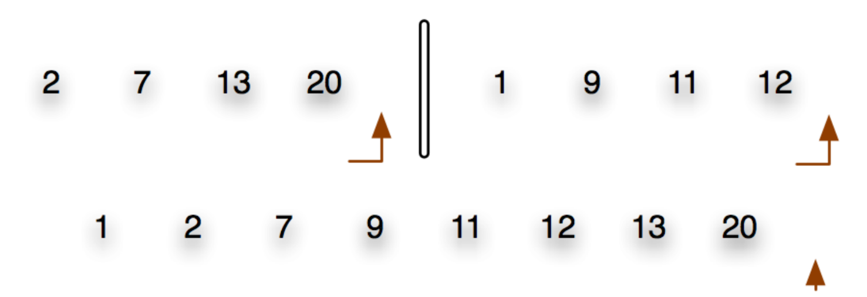
Merge (Simulation)

Slide 25
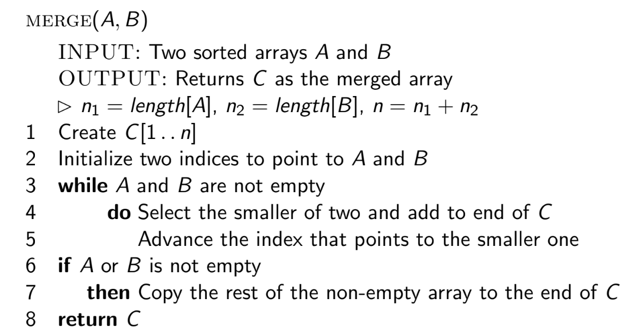
Merge (Algorithm)

Slide 26
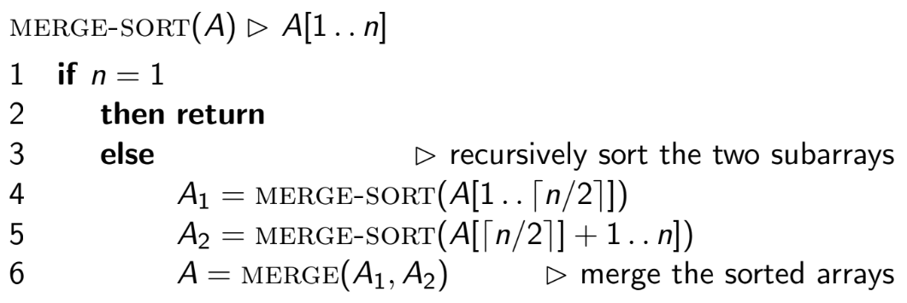
Merge Sort (Algorithm)
Out-of-Place Algorithm

Slide 27
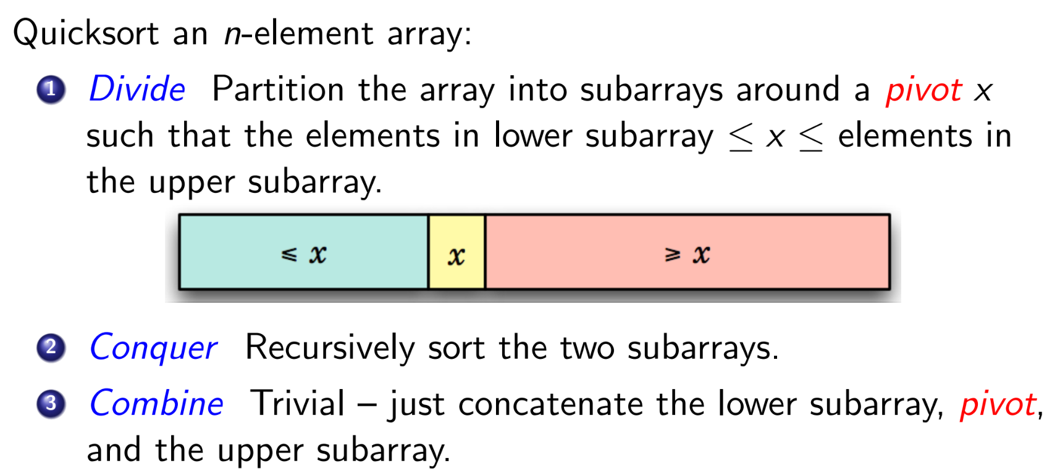
Quick Sort

Slide 28
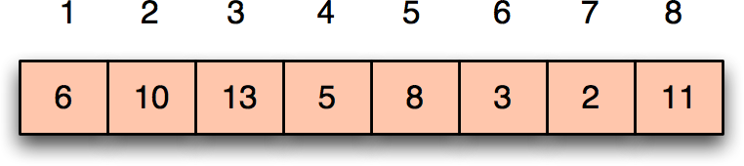
Quick Sort (Simulation)

Slide 29
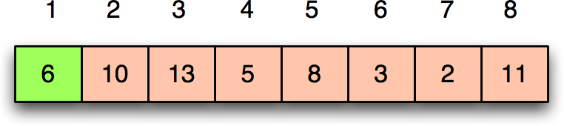
Quick Sort (Simulation)

Slide 30
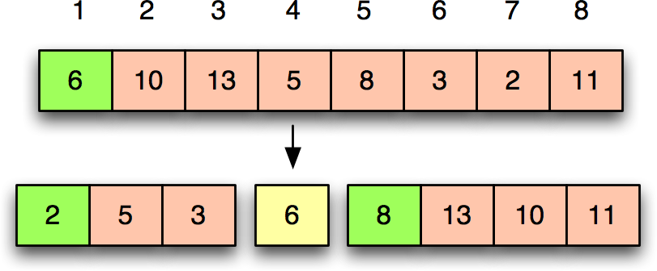
Quick Sort (Simulation)

Slide 31
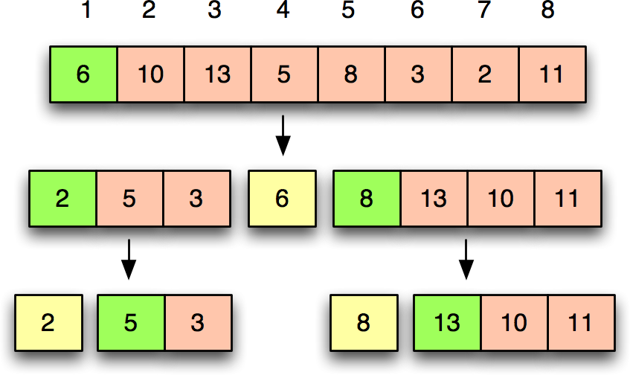
Quick Sort (Simulation)

Slide 32
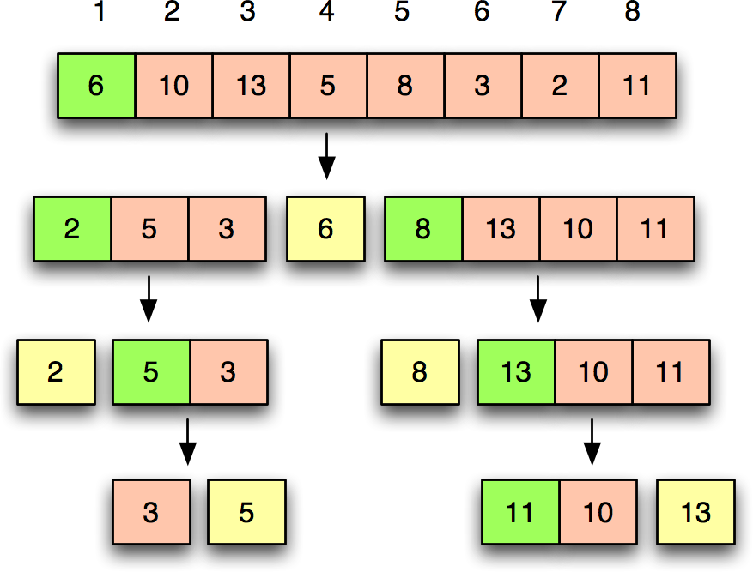
Quick Sort (Simulation)

Slide 33
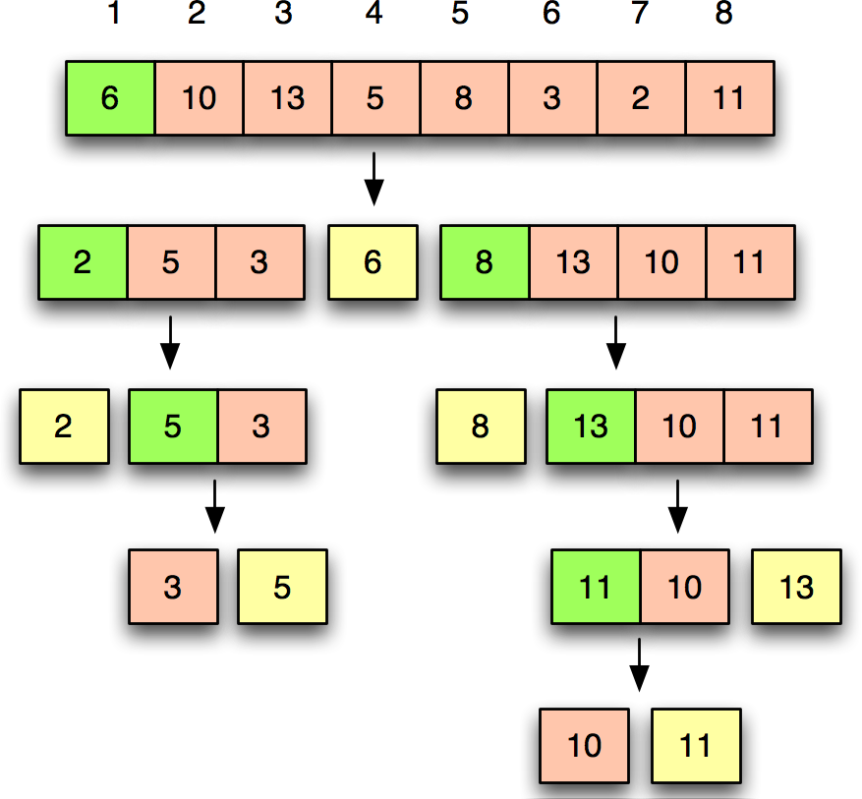
Quick Sort (Simulation)

Slide 34
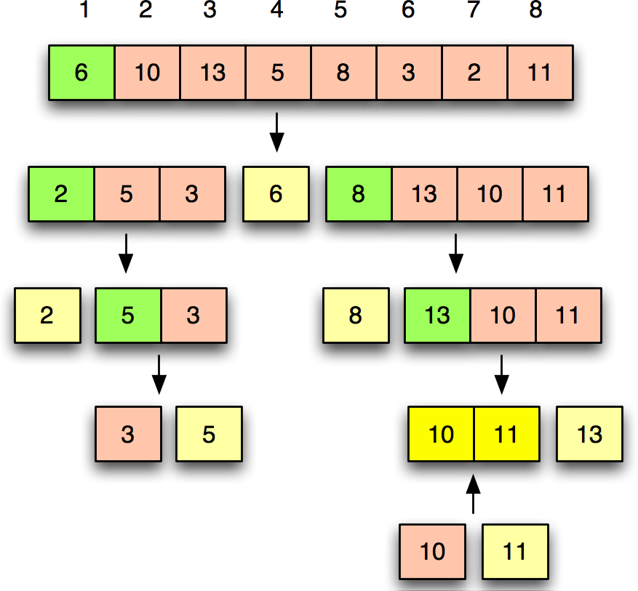
Quick Sort (Simulation)

Slide 35
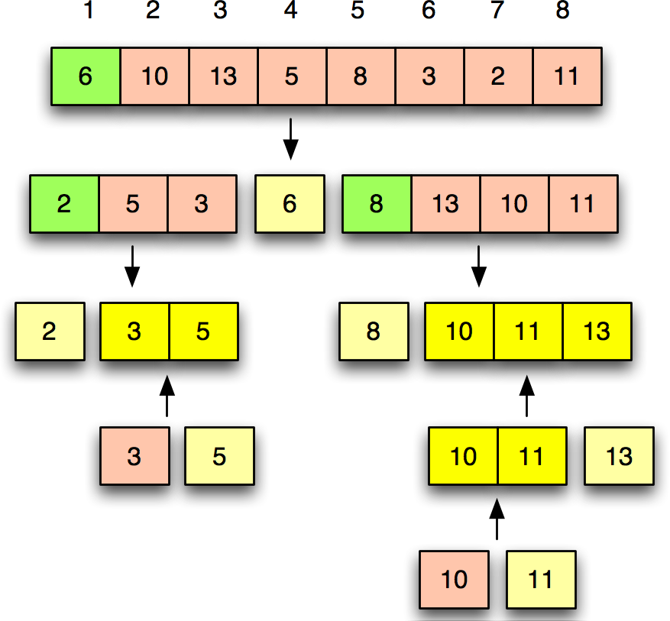
Quick Sort (Simulation)

Slide 36
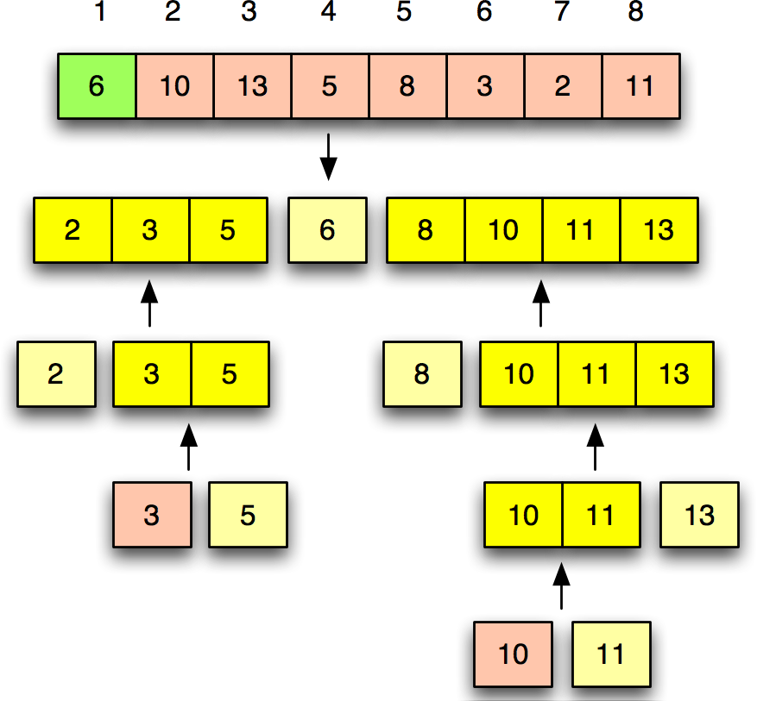
Quick Sort (Simulation)

Slide 37
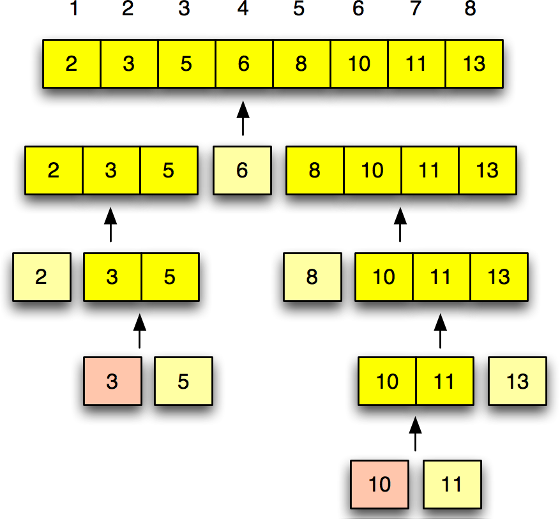
Quick Sort (Simulation)

Slide 38
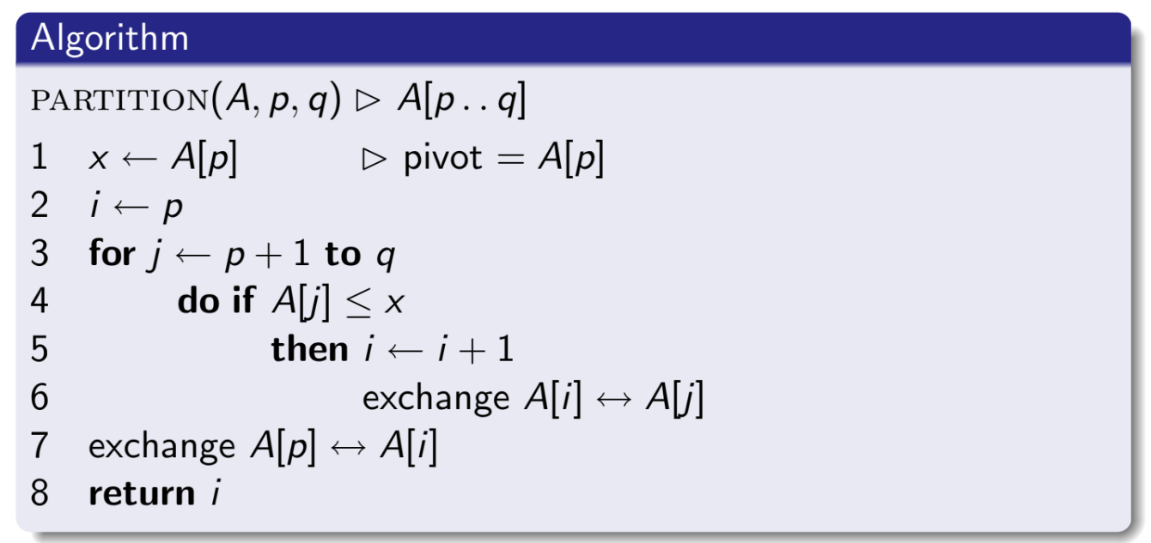
Partitioning (Algorithm)

Slide 39
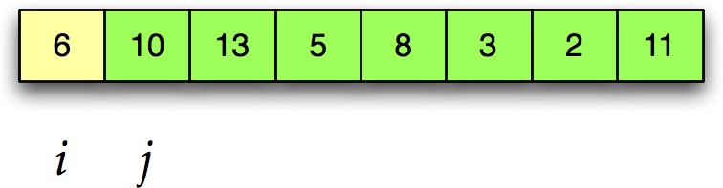
Partitioning (Simulation)

Slide 40
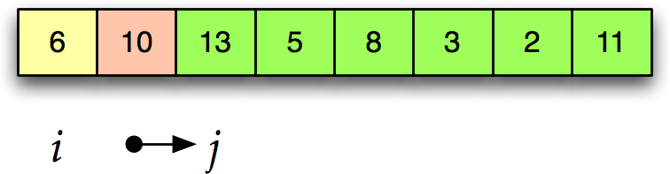
Partitioning (Simulation)

Slide 41
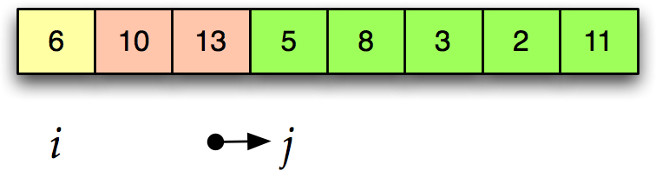
Partitioning (Simulation)

Slide 42
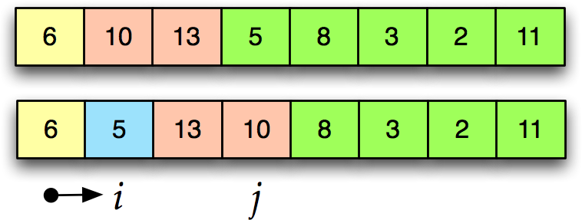
Partitioning (Simulation)

Slide 43
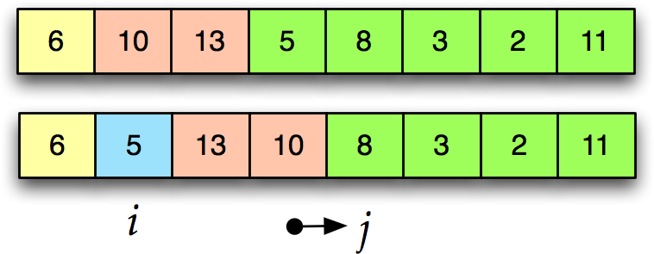
Partitioning (Simulation)

Slide 44
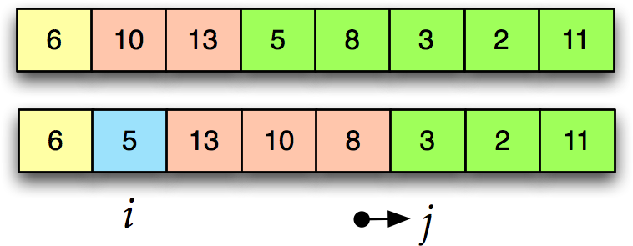
Partitioning (Simulation)

Slide 45
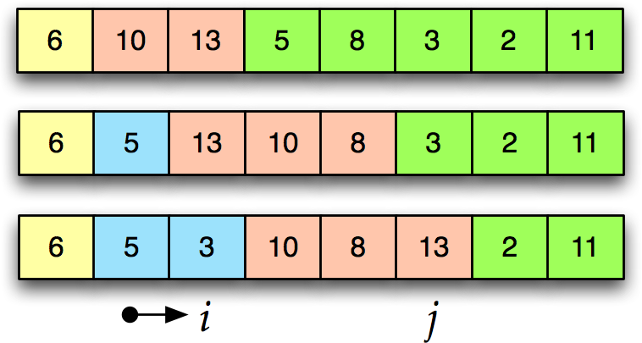
Partitioning (Simulation)

Slide 46
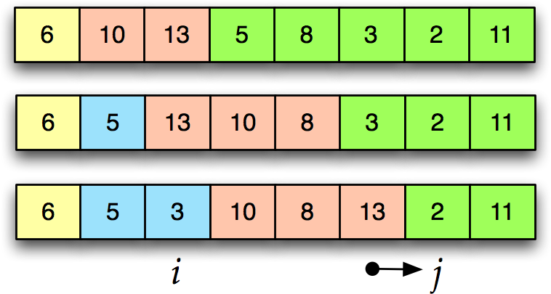
Partitioning (Simulation)

Slide 47
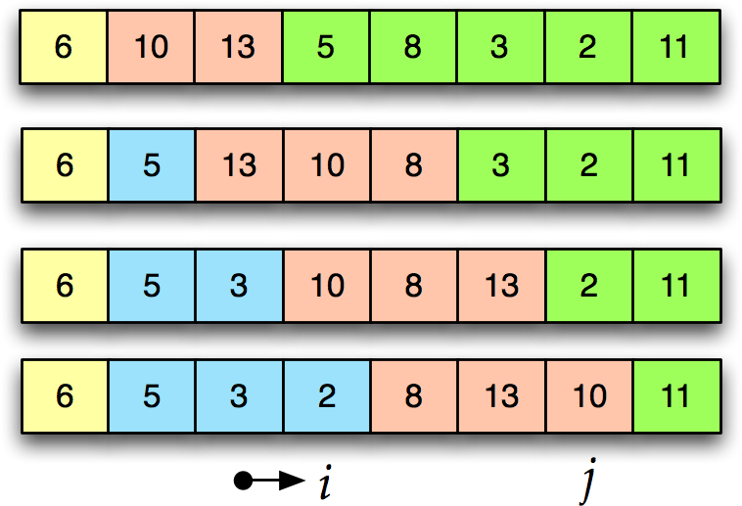
Partitioning (Simulation)

Slide 48
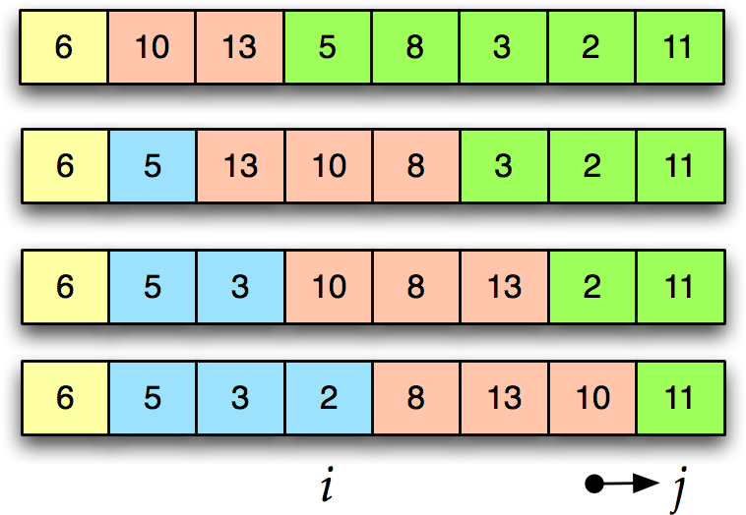
Partitioning (Simulation)

Slide 49
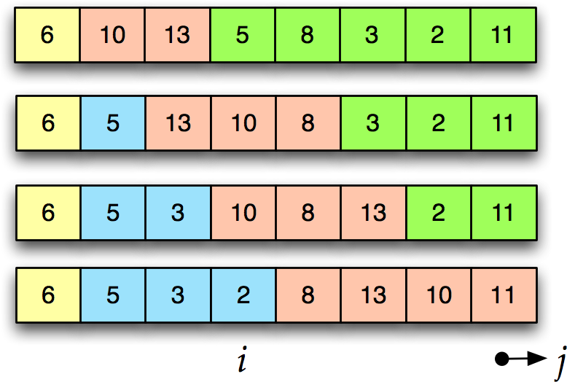
Partitioning (Simulation)

Slide 50
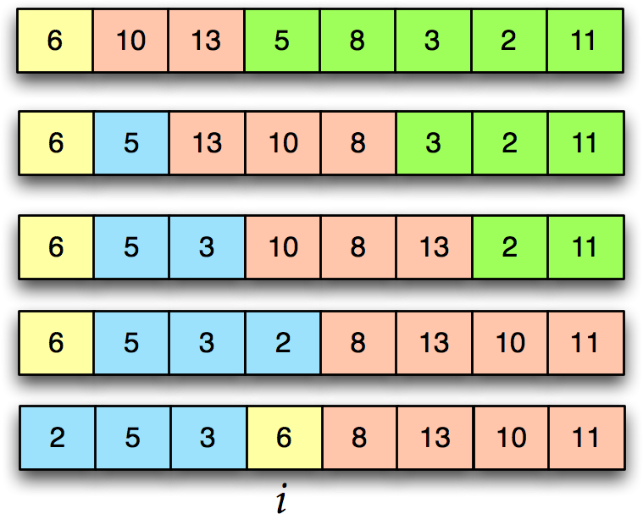
Partitioning (Simulation)

Slide 51
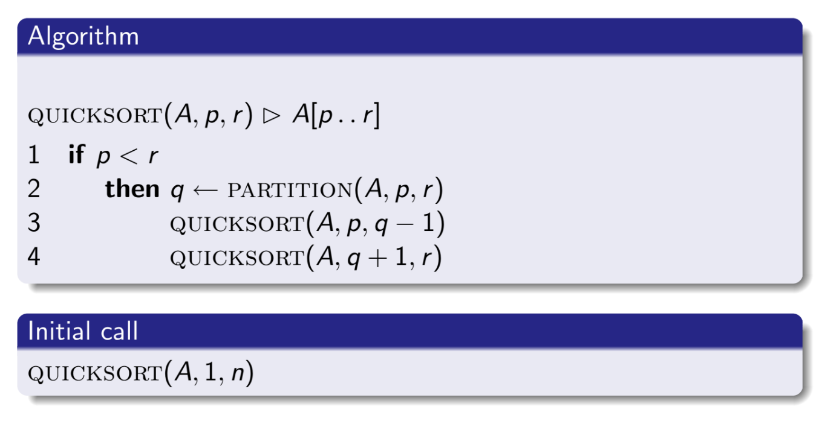
Quick Sort (Algorithm)

Slide 52
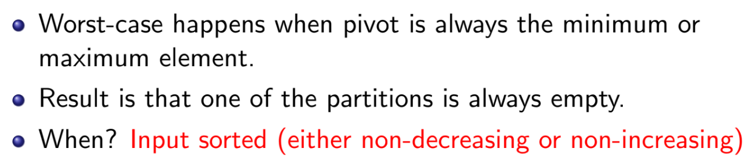
Quick Sort (Soft Analysis - Worst Case)

Slide 53
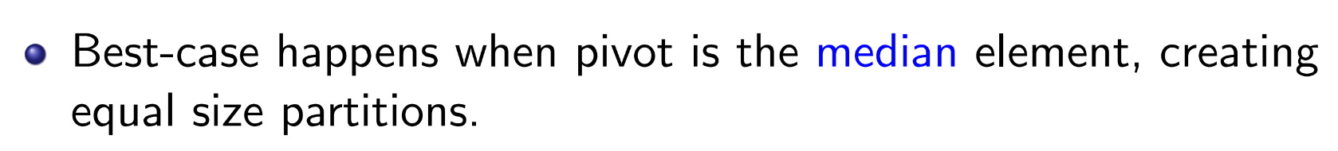
Quick Sort (Soft Analysis - Best Case)

